Slide 1
Genomics and Bioinformatics
Jean Pierre Musabyimana, MSc, MGHD, PhDc
Infection Biologist and global Health researcher
1

Slide 2
Course Overview
Introduction – Review/Big Picture - Brief History, Types of genomes, Informational Content
Module 1 – Structural Genomics
Module 2 – Functional Genomics
Module 3 – Comparative Genomics
2

Slide 3
Course Grading
Test 1 – Covers Module 1 – 15%
Assignment 1 – Bacterial Genome Assembly/Annotation/Exploration – 15%
Test 2 – Covers Module 2 – 20%
Assignment 2 – RNA-Seq Differential Expression Analysis of plants under stress – 15%
Test 3 – Covers Module 3 – 20%
Assignment 3 – Constructing a phylogenetic tree of SARS-Cov 2 – 15%
Extra marks: be active in class, ask or answer questions
Data interpretation type questions, understanding of material (read the papers!)
3

Slide 4
Course content
Introductory Module 1) Brief History 2) Types of genomes 3) Structural vs Functional vs Comparative Genomics 4) What questions can we answer with Genomics?
Module 1 – Structural Genomics 1) Chromosome structure/number and gene mapping 2) Epigenetics 3) Genome sequencing technologies 4) Assembly of genomes 5) Annotation of genomic DNA 6) Genetic markers and mutations
Assignment 1 – Assemble, annotate and explore a small bacteria genome with Galaxy or with BASH, Python and R (switching from different tools
Module 2 – Functional Genomics 1) Sequence alignment 2) Annotating protein function with BLAST 3) Methods of determining protein function and interactions 4) Proteomic analysis 5) Transcriptome analysis of gene expression
Assignment 2 – Analyze RNA-Seq data to identify differentially expressed genes in nematode infested Arabidopsis
Module 3 – Comparative Genomics 1) Homologs/paralogs/orthologs 2) Genome wide association studies 3) Genome evolution 4) Phylogenetic analysis
Assignment 3 – Retrieve viral sequences and construct phylogenetic trees to determine evolution of SARS-COV 2
1

Slide 5
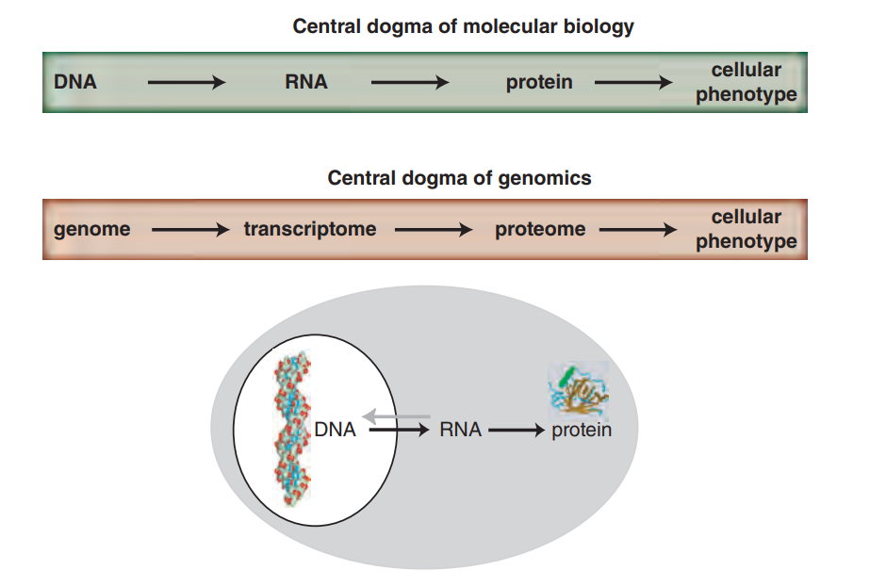
What is Genomics?
At its most basic, genomes are the complete DNA content of an organism
DNA contains GENES -> transcribed to RNA -> encode protein -> Produce a phenotype
Genomics seeks to understand the informational content of ALL of these components, their interactions and ultimately phenotype
5

Slide 6
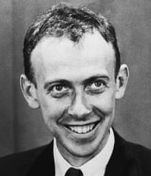
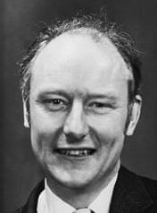
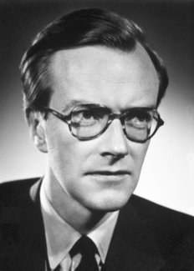
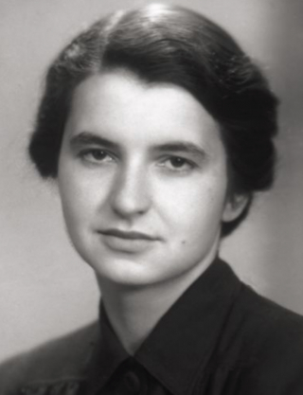
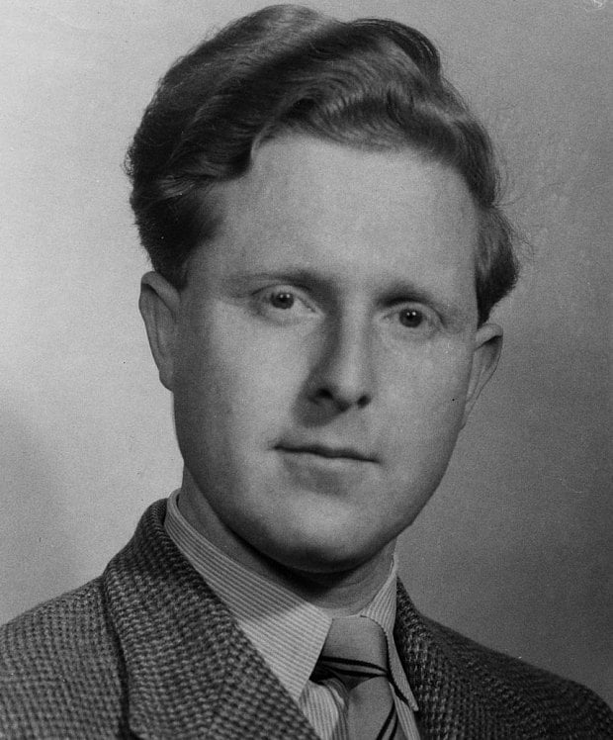
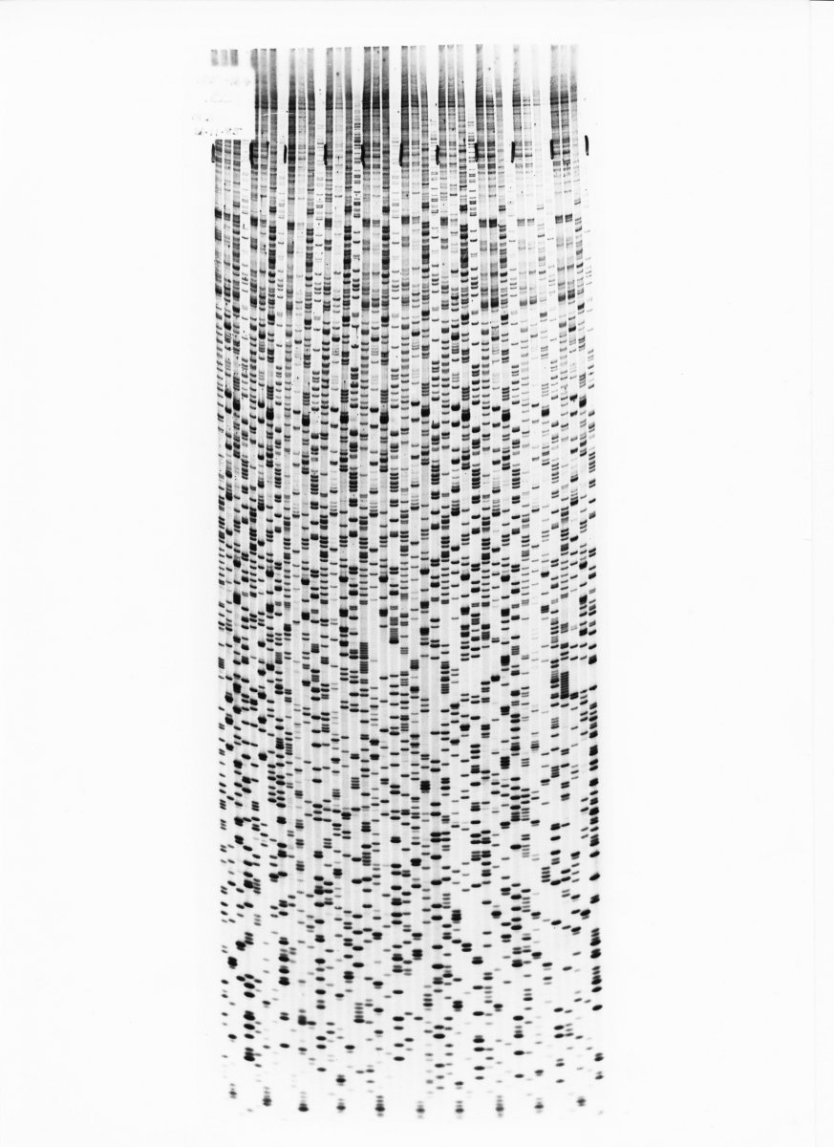
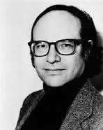
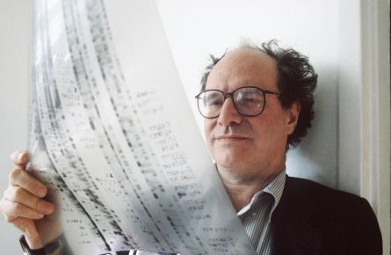
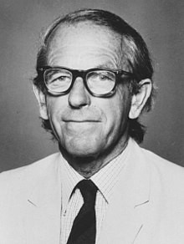
BRIEF History of Genomics
1953 – Watson, Crick, Wilkins, Franklin, Gosling – DNA double helix – Modern biology
1977-80 - Allan Maxam, Walter Gilbert, Frederick Sanger – Invention of DNA Sequencing!
6
Notes:
https://science.sciencemag.org/content/291/5507/1195.full

Slide 7
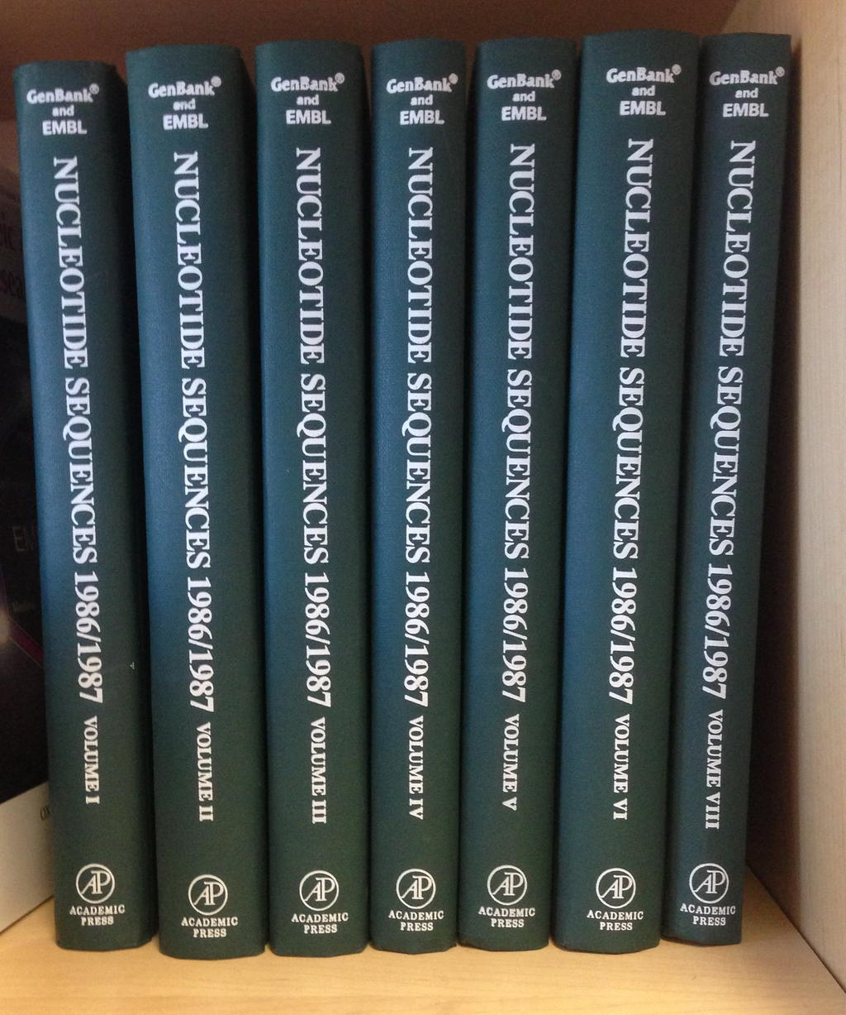


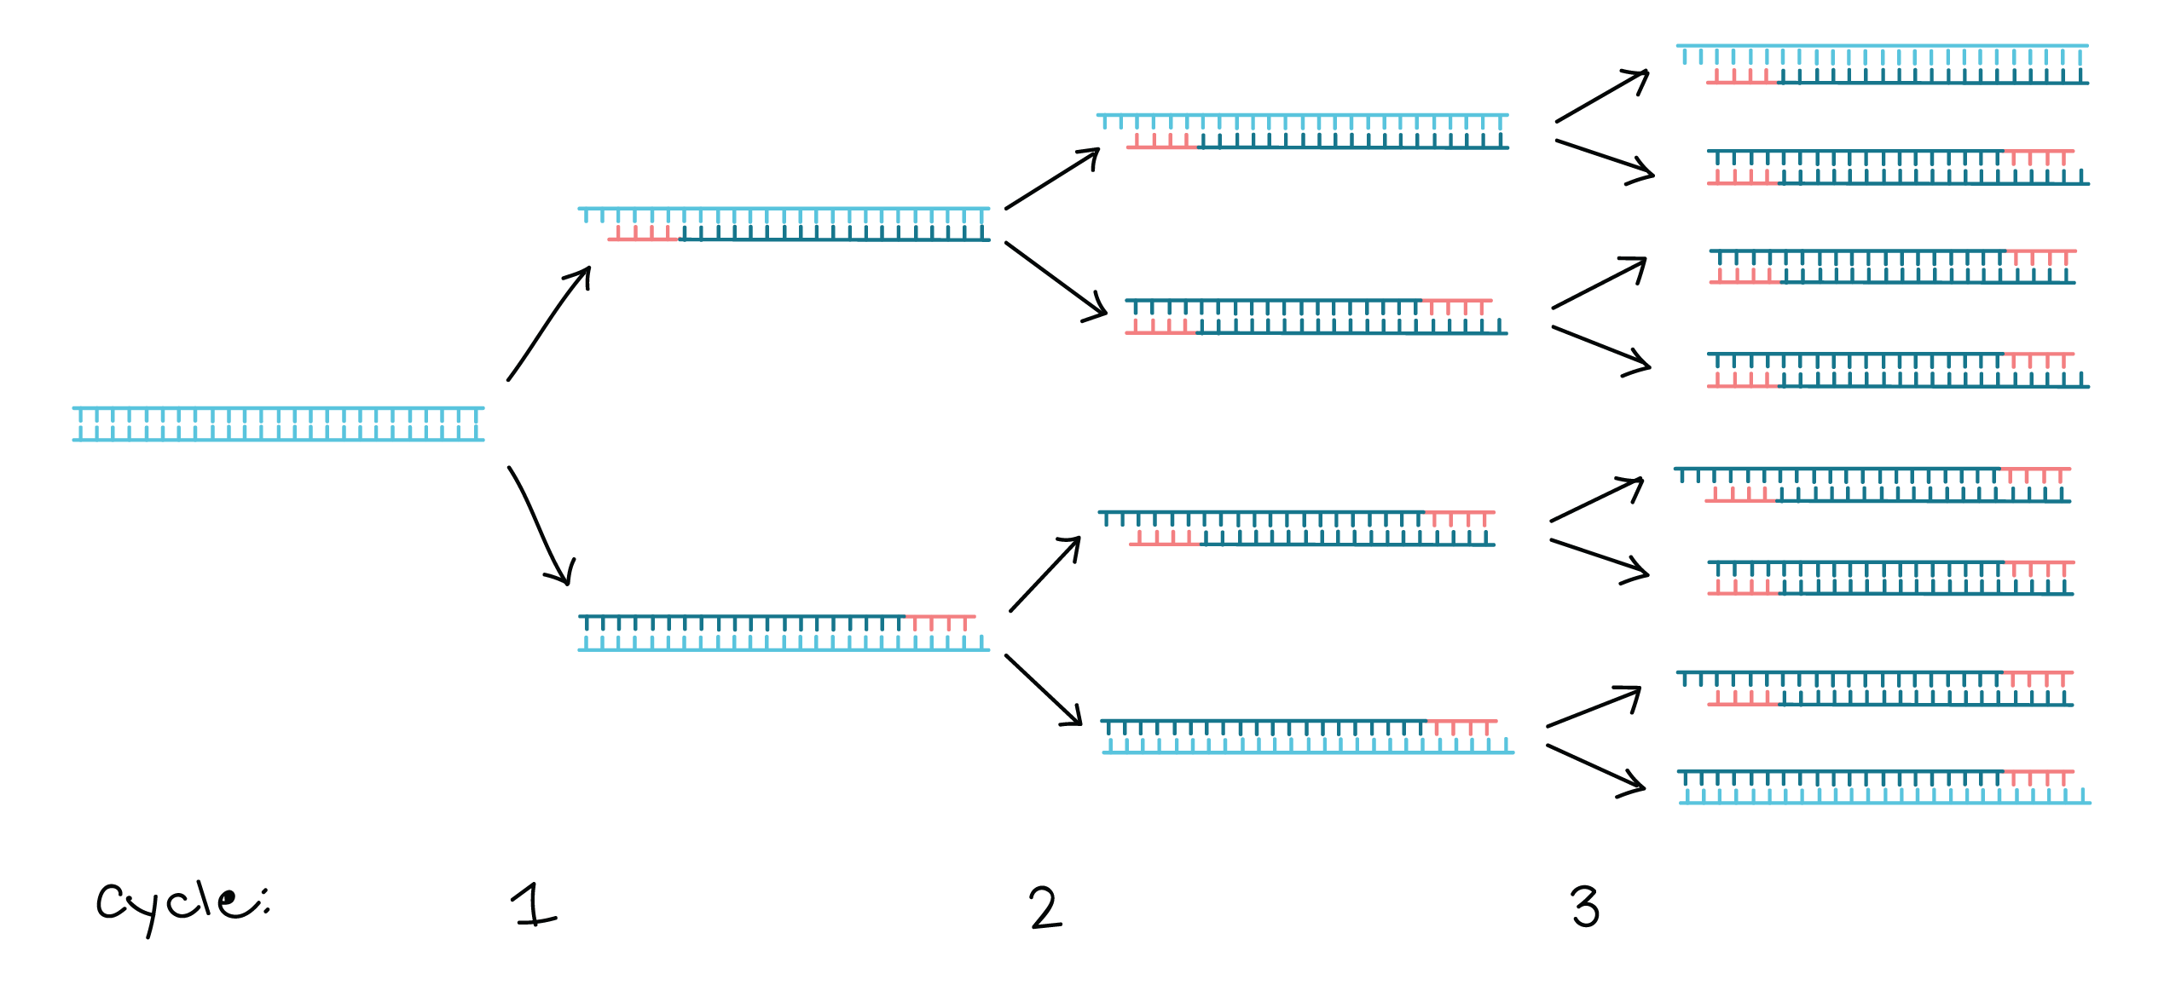
BRIEF History of Genomics
1982 – GenBank founded by Walter Goad – First and most popular sequence database!
1983 – Kary Mullis – Invented polymerase chain reaction (PCR)
1985-87 – Conversations begin about sequencing human genome
Department of Energy + National Institute of Health -> Human Genome Project consortium (HGP)
1998 – J. Craig Venter founds Celera – Competitor to HGP
2000 – Celera publishes genome sequence of Drosophila using shotgun sequencing
2001 – February 15th -> HGP published human draft genome February 16th -> Celera
7
Notes:
https://science.sciencemag.org/content/291/5507/1195.full

Slide 8
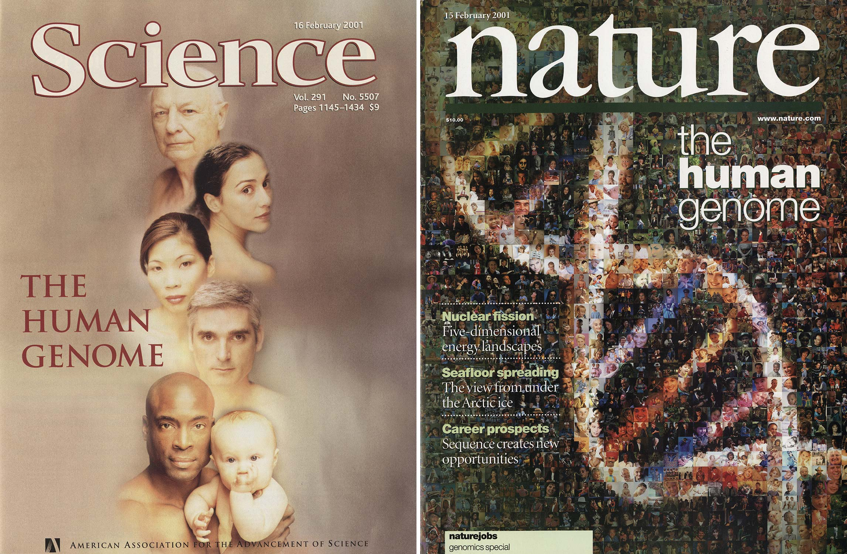
Modern Genomics
The first draft human genomes were released in 2001 – start of modern genomics
What did we find?
3 BILLION base pairs (bp) in the haploid genome (2 meters in length)
19-21,000 protein coding genes (2% of genome)
Non coding genes 24,000
Small non coding genes 4,872 (small RNAs)
Long non coding genes 16,907 (long non-coding RNAs)
Misc non coding genes 2,221
Pseudogenes 15,229
Humans vary only about 0.01% in their DNA content
8
Notes:
https://science.sciencemag.org/content/291/5507/1195.full

Slide 9
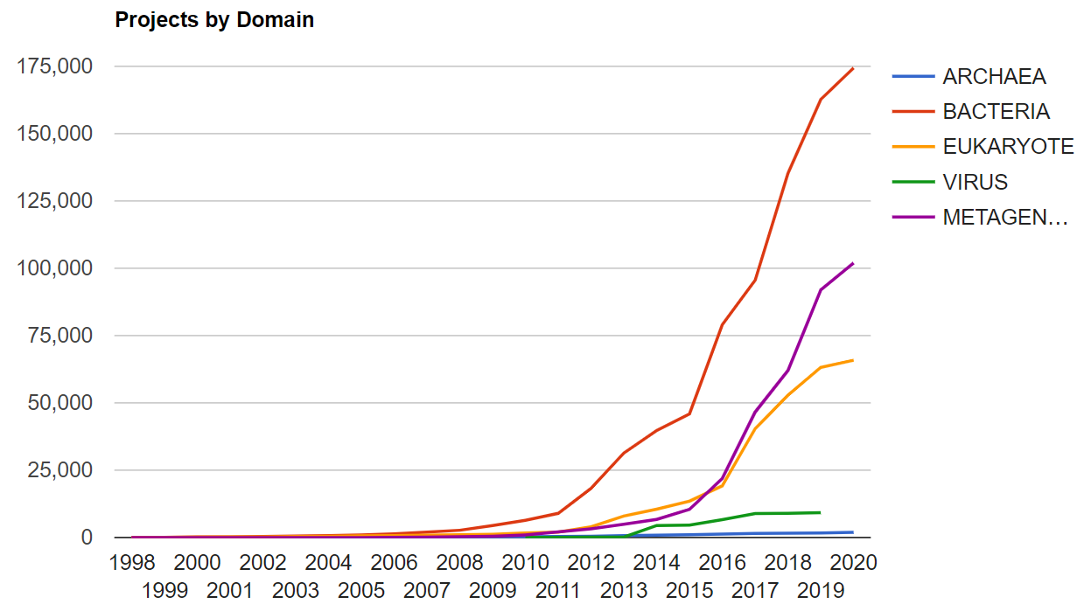
Modern Genomics
HGP paved the way for sequencing the rest of life
Sequencing many genomes allow comparisons across all life
Organism | Complete | Draft assembly | In progress | total
Prokaryotes | 1117 | 966 | 595 | 2678
Archaea | 100 | 5 | 48 | 153
Bacteria | 1017 | 961 | 547 | 2525
Eukaryotes | 36 | 319 | 294 | 649
Animals | 6 | 137 | 106 | 249
Mammals | 3 | 41 | 25 | 69
Birds |  | 3 | 13 | 16
Fishes |  | 16 | 16 | 32
Insects | 2 | 38 | 17 | 57
Flatworms |  | 3 | 3 | 6
Roundworms | 1 | 16 | 11 | 28
Amphibians |  | 1 |  | 1
Reptiles |  | 2 |  | 2
Other animals |  | 20 | 24 | 44
Plants | 5 | 33 | 80 | 118
Land plants | 3 | 29 | 73 | 105
Green Algae | 2 | 4 | 6 | 12
Fungi | 17 | 107 | 59 | 183
Ascomycetes | 13 | 83 | 38 | 134
Basidiomycetes | 2 | 16 | 11 | 29
Other fungi | 2 | 8 | 10 | 20
Protists | 8 | 39 | 46 | 93
Apicomplexans | 3 | 11 | 16 | 30
Kinetoplasts | 4 | 3 | 2 | 9
Other protists | 1 | 24 | 28 | 53
total: | 1153 | 1285 | 889 | 3327
9

Slide 10
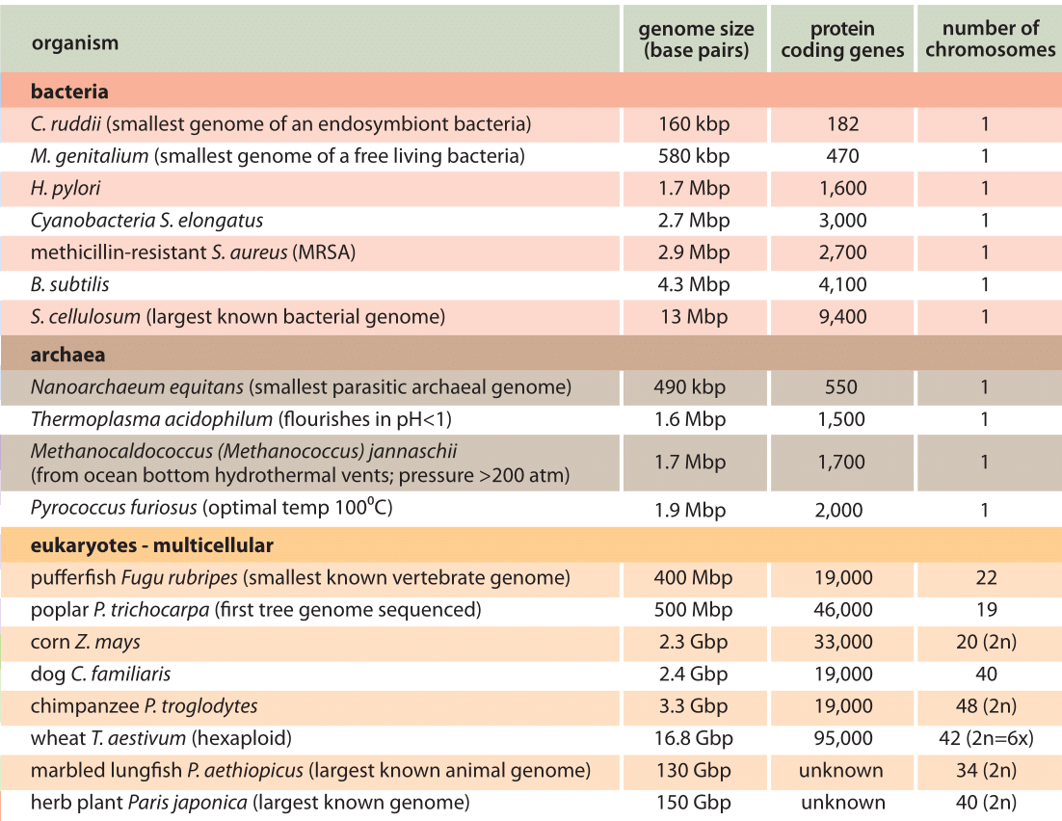
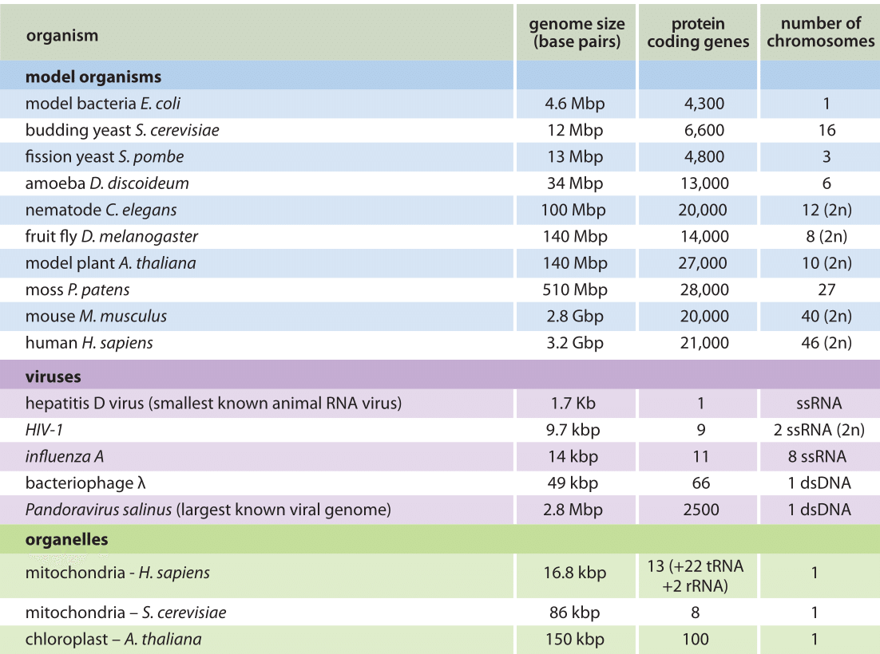
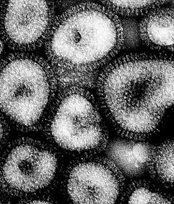
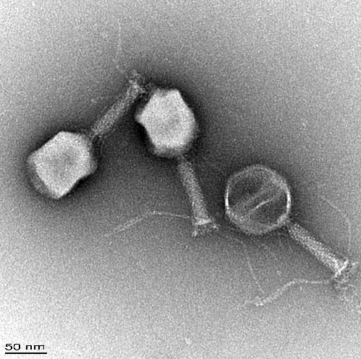
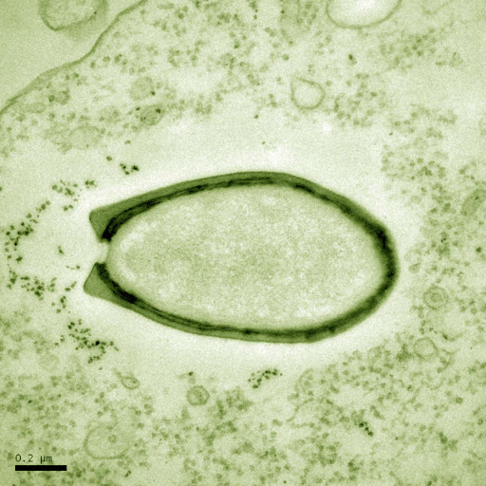
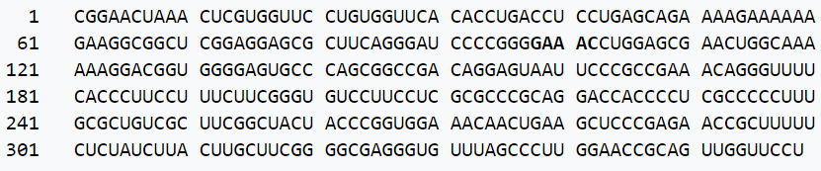
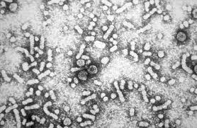
Types of genomes
Genome sizes, organization, content vary greatly across life
Viruses -> Smallest genomes, from viriods (300-400bp) to bacterial sized genome (2.8 Mbp)
ss/dsDNA or ss/dsRNA linear or circular, mono or multi-partite (not copies)
“Easier” Genomics due to small size of genome, low number of coding proteins
“Harder” due to high rate of mutation -> many sequences in one infection
number of
genome
molecules
PSTVd
Hepatitis
Influenza
Bacteriophage
Pandoravirus
10
Notes:
http://book.bionumbers.org/how-big-are-genomes/

Slide 11
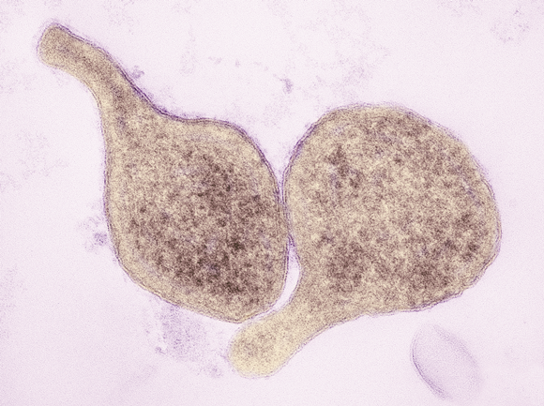

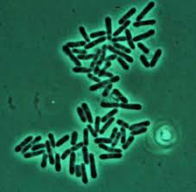
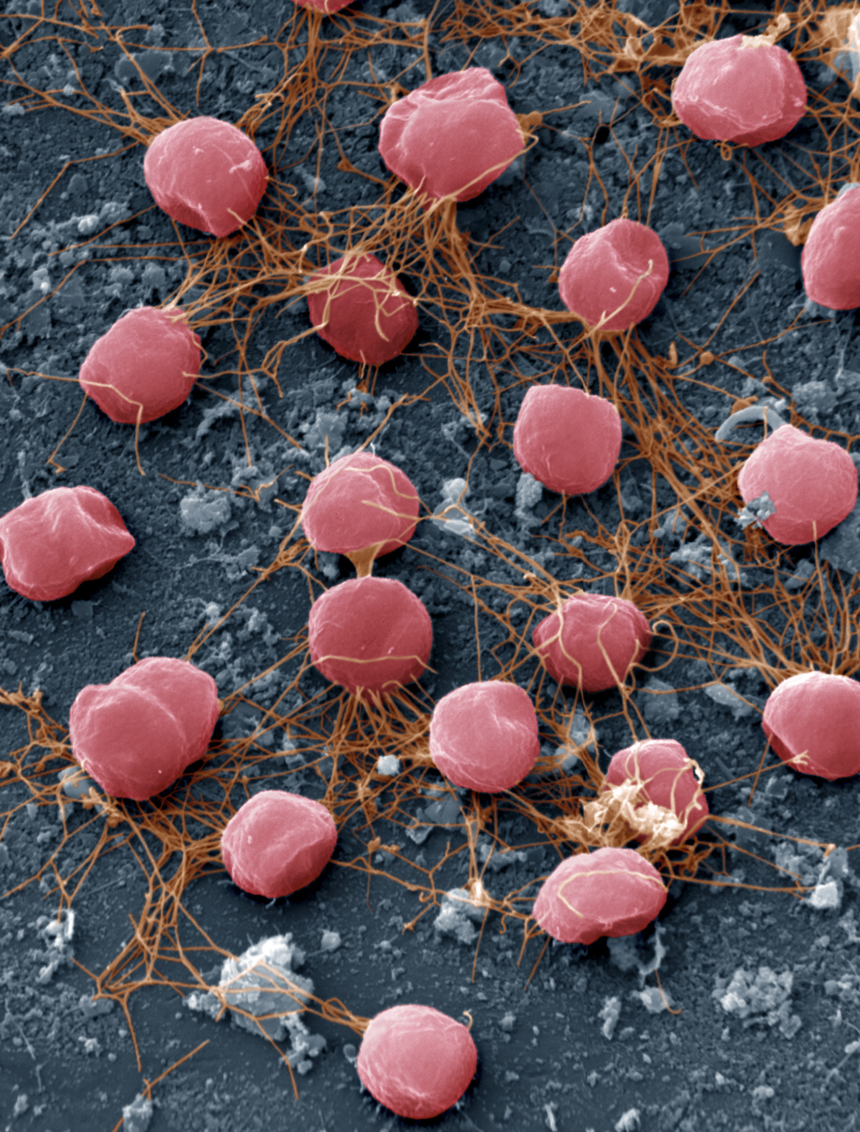
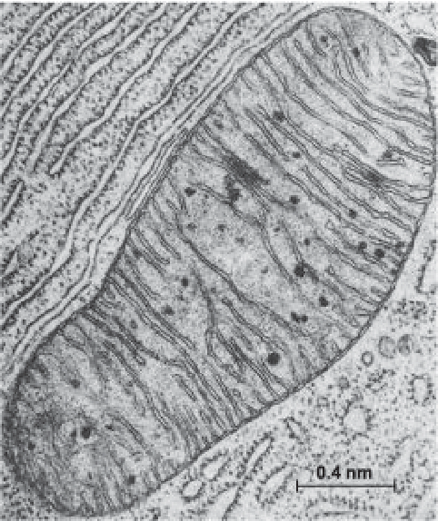
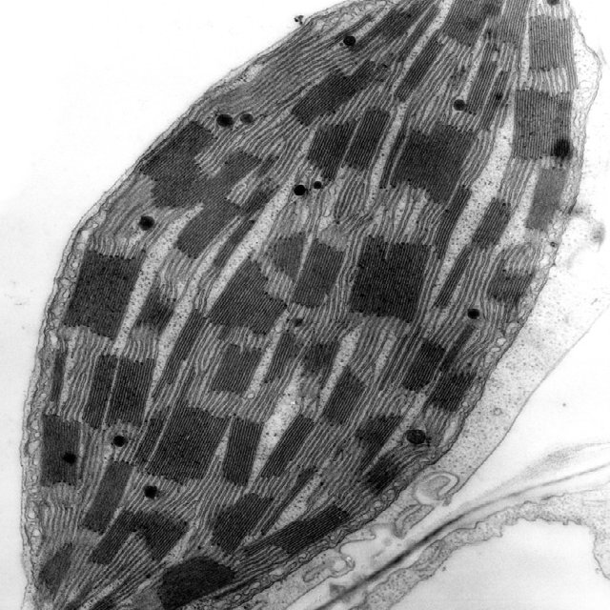
Types of genomes
Prokaryotes (Bacteria, archaea, organellar) -> 16 Kbp (organelles) to 13 Mbp, usually 2-4 Mbp
dsDNA, usually circular, sometimes linear chromosome
Easy to medium genomics -> Larger than viruses, still a single chromosome! Medium number of protein coding genes
11

Slide 12


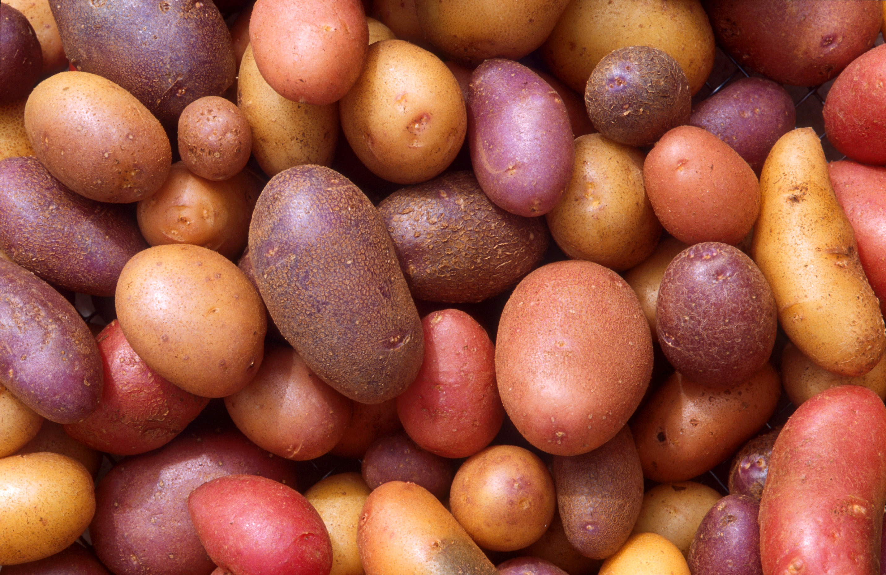
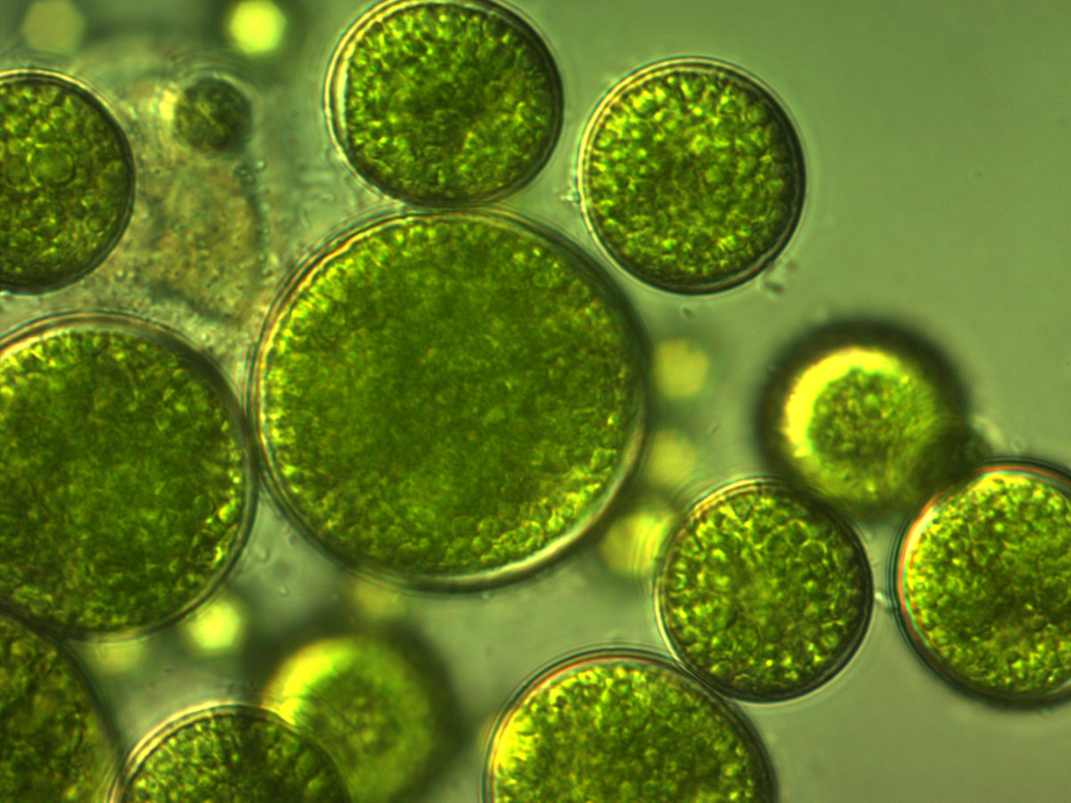
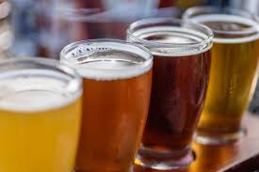
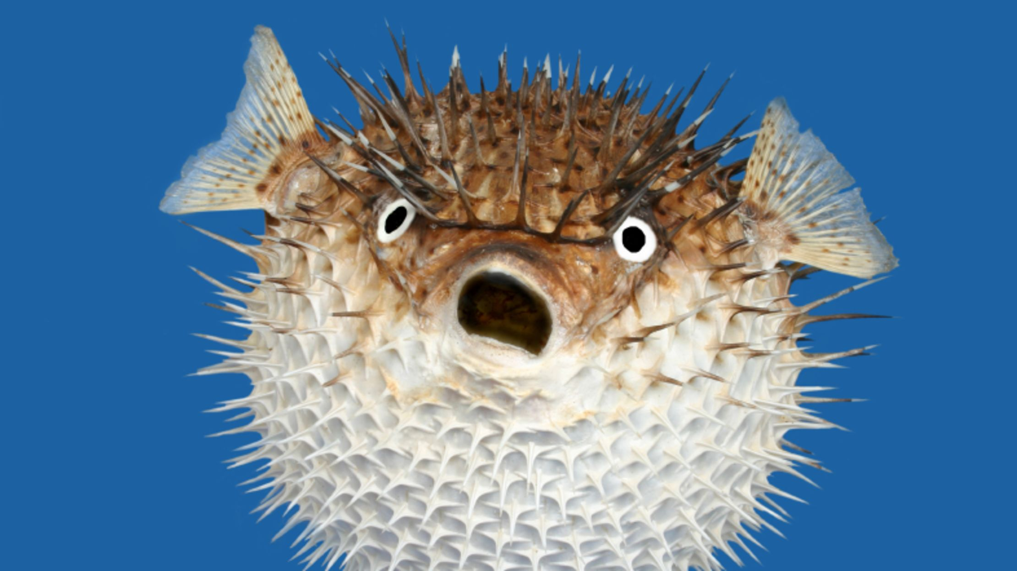
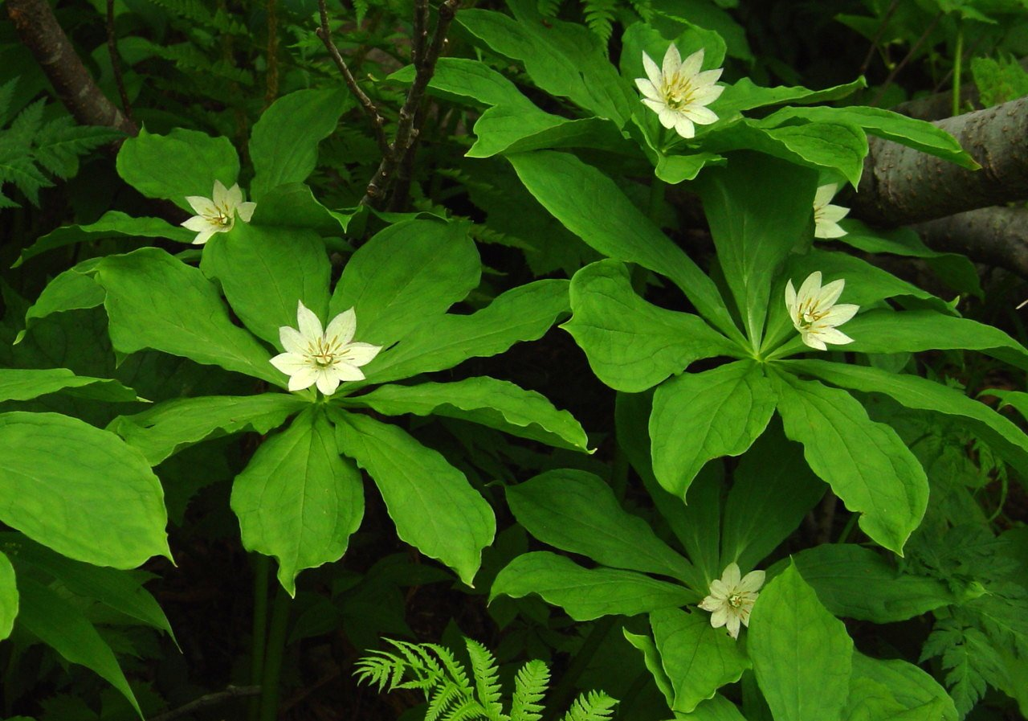
Types of genomes
Eukaryotes -> 12 Mbp (Algae, yeast) to humans (3.2 Gbp) to land plants (up to 150 Gbp!!!)
double stranded DNA (dsDNA), multiple chromosomes, multiple copies of each (monoploid, diploid, polyploid)
Hardest to study from a genomics perspective, very large, multiple alleles, tens of thousands of protein coding genes
12

Slide 13
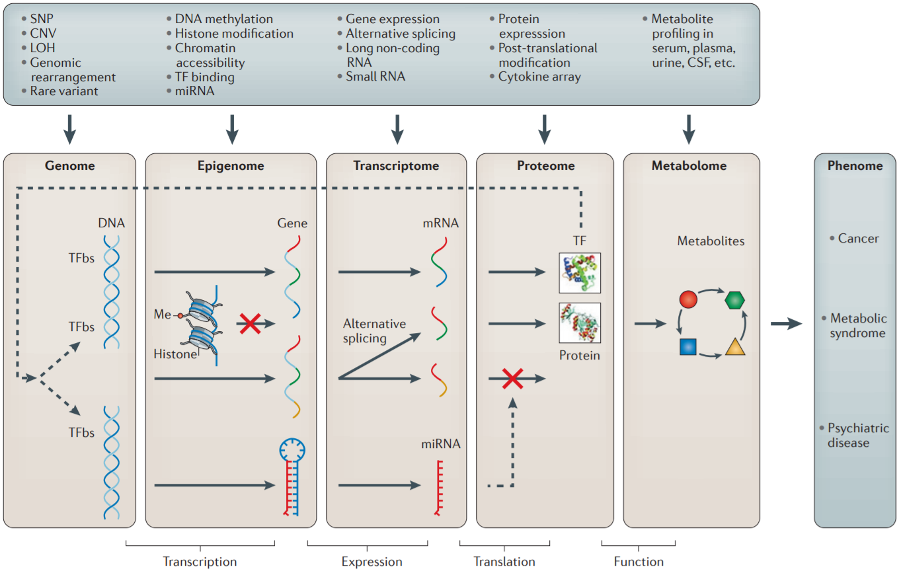
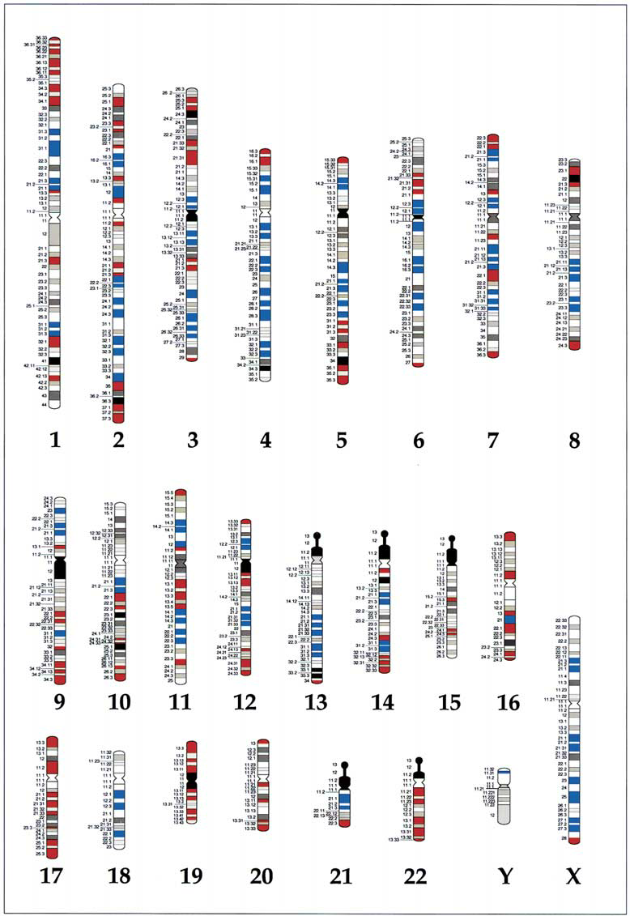
Information Content of Genomes
Layers of information in -omics, inter-related, provide more evidence than a single layer
High-throughput, computational approach defines –omics disciplines
Enabled by access to high-throughput DNA sequencing
Study of layers -> Genomics -> Structural genomics, Functional genomics, Comparative genomics
Chromosomes
10
Notes:
Methods of integrating data to uncover genotype–phenotype interactions

Slide 14
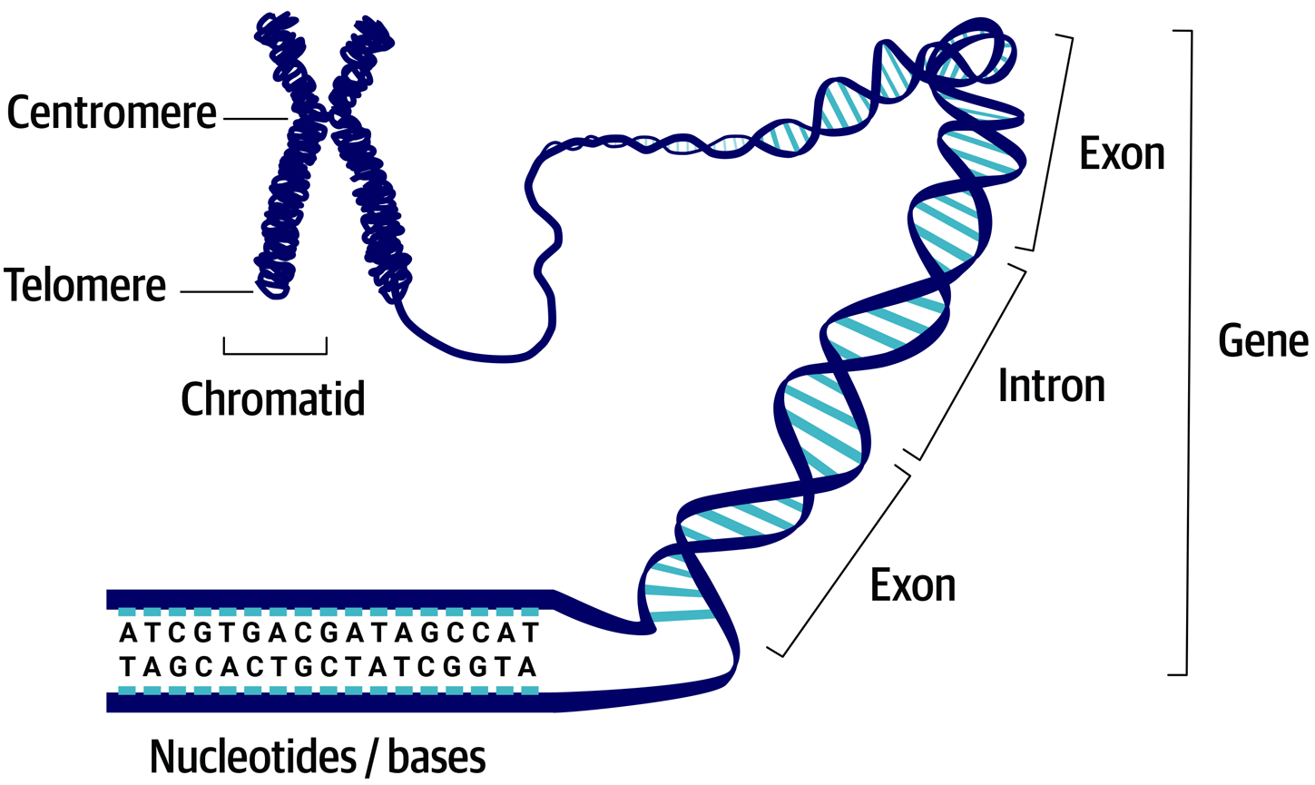
What is Structural Genomics?
Structural genomics describes the physical structure and DNA content of a genome
Chromosomes – Structure? Number? Physical map?
Epigenome – What DNA is accessible? Is it methylated?
What is the conformation of the DNA?
Genomic DNA – How do we sequence a genome?
How do we assemble a genome, annotate it?
13
Notes:
https://www.ncbi.nlm.nih.gov/books/NBK21841/

Slide 15
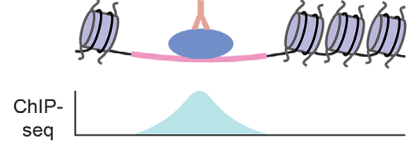
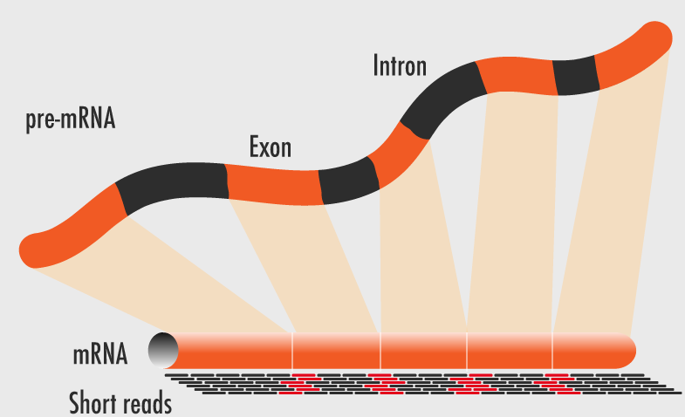
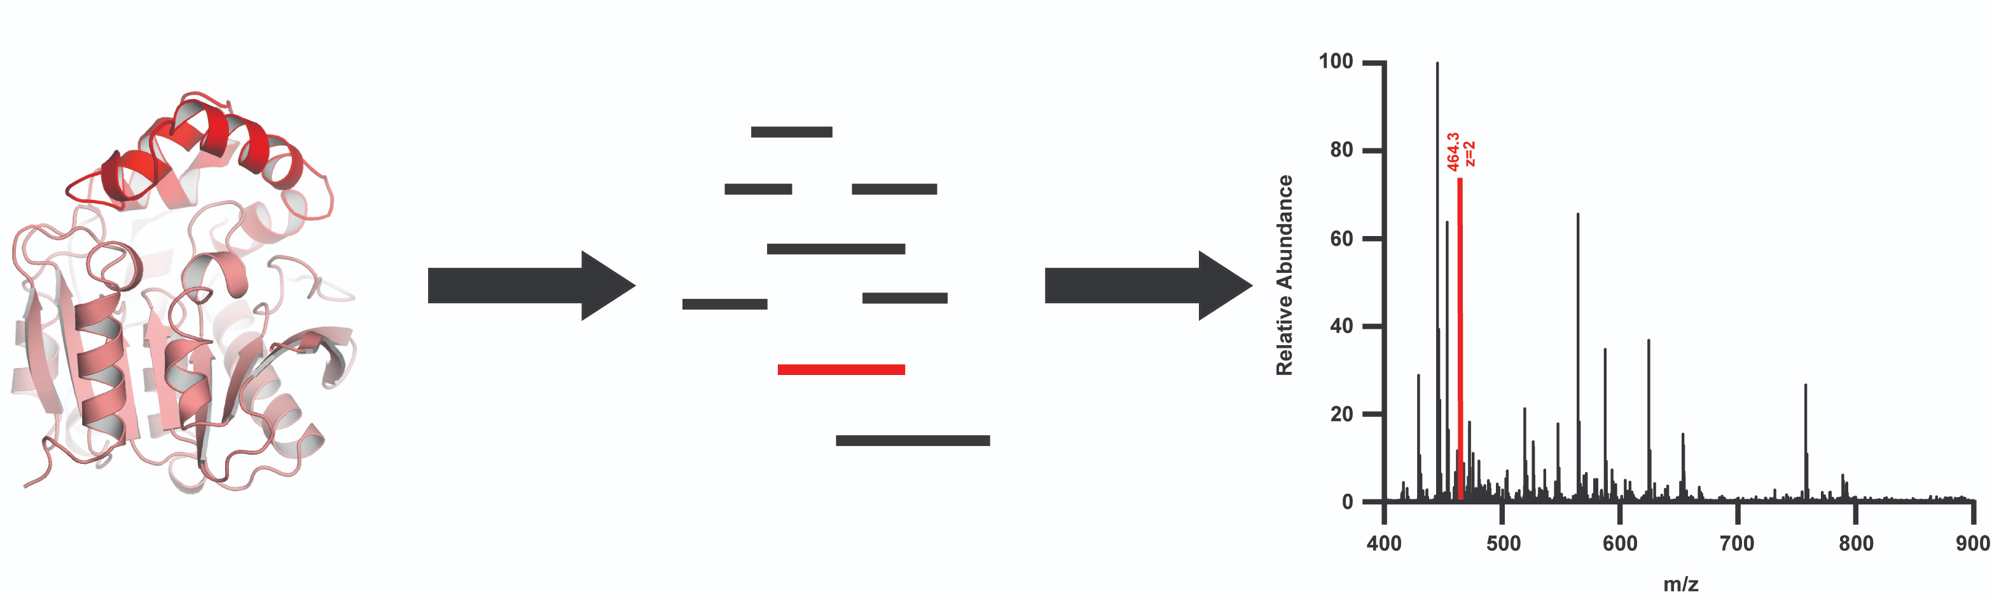
What is Functional Genomics?
Characterizing the function of DNA, RNA and Protein of genome is Functional genomics
DNA -> Is it being transcribed or not? What is binding to the DNA?
RNA -> How much is there? Is it being spliced? Processed? Translated?
Protein -> How much is there? Protein-DNA/RNA/Protein interactions?
14

Slide 16
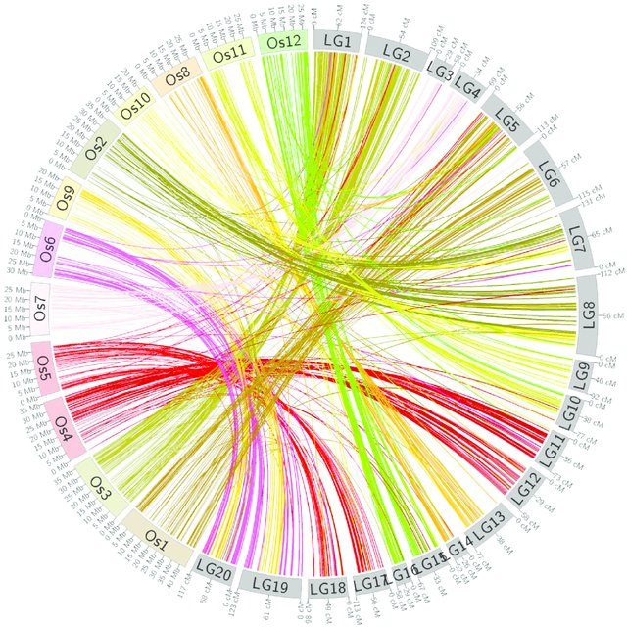
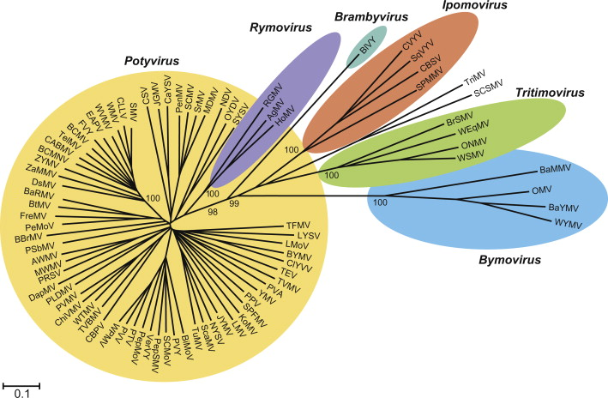
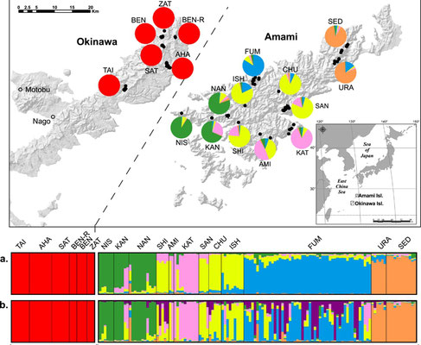
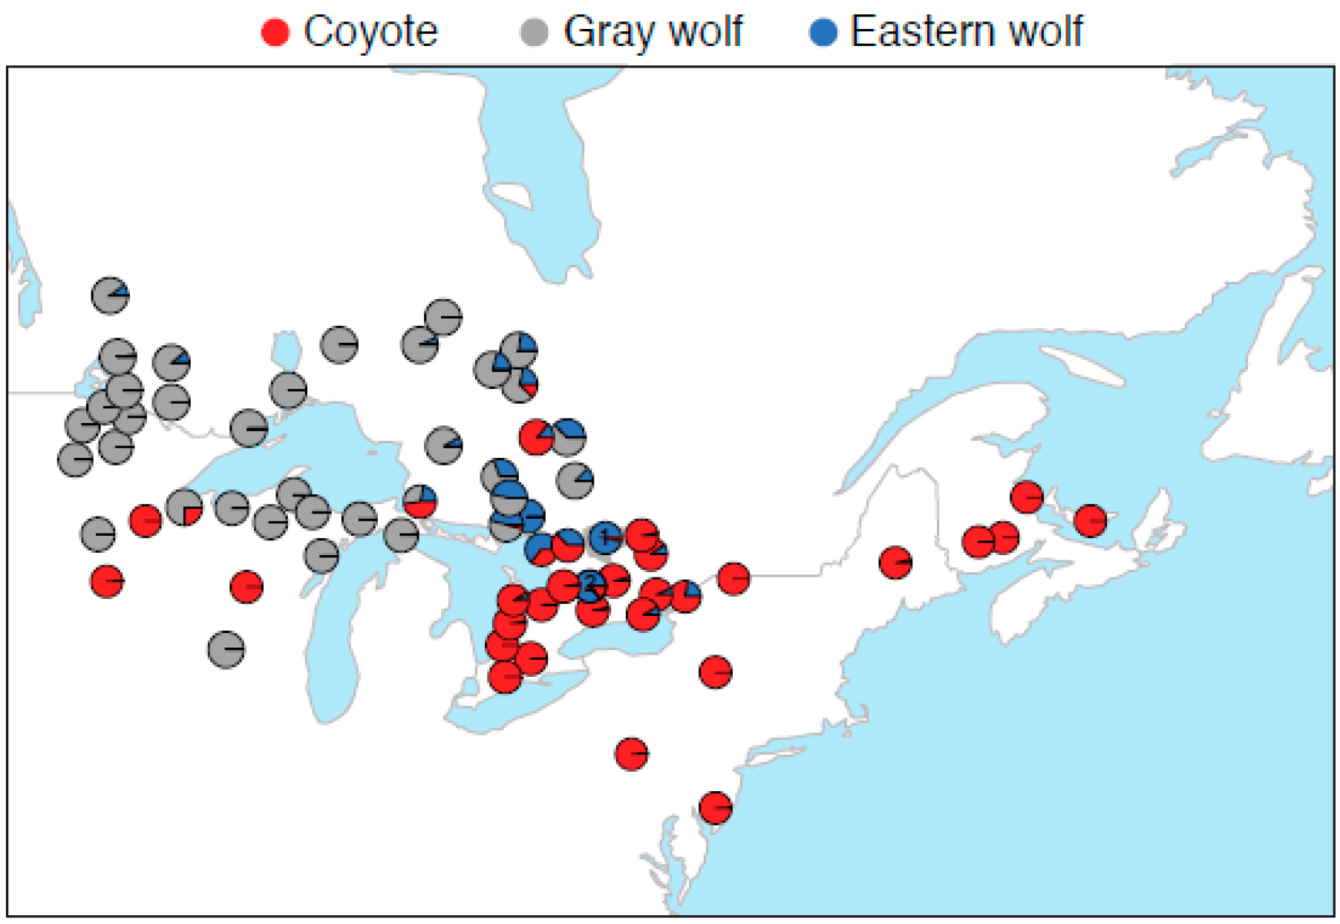
What is Comparative Genomics?
>1 genome sequenced? Why not compare them?
What are the similarities and differences between organisms?
Human vs Chimp? 97%. Human vs Yeast? 30%!
How did organisms evolve over time?
Evolution of DNA and chromosomes
What about populations? Ecology?
15

Slide 17
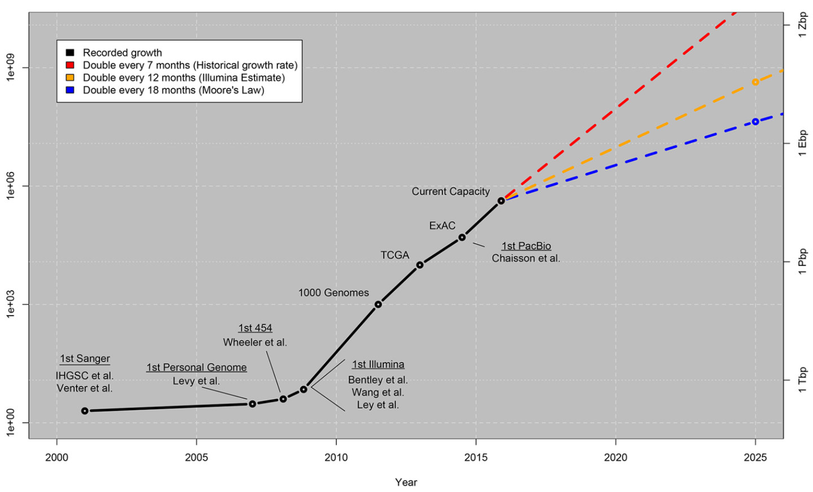
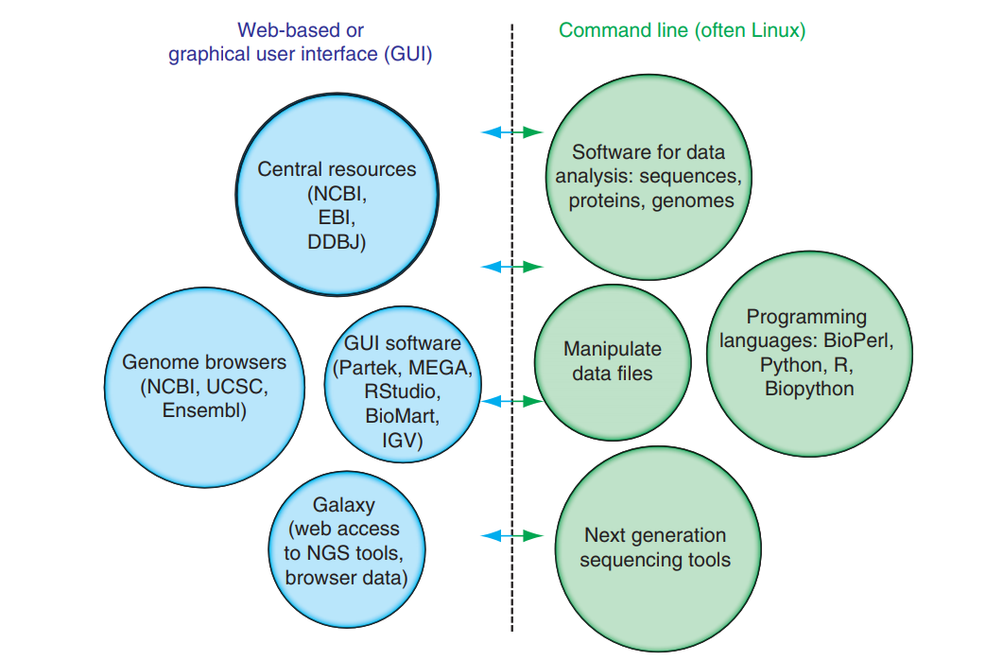
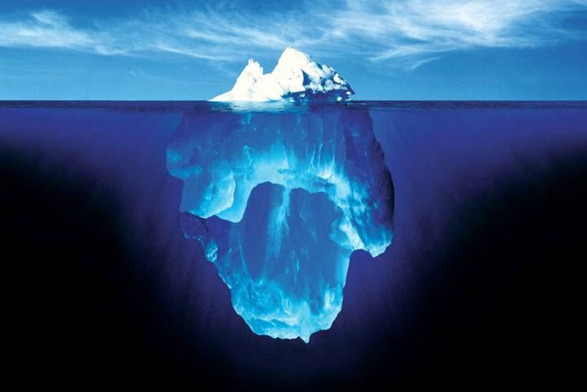
What is bioinformatics?
All this data (Gigabytes, terabytes, petabytes) what do we do with it all???
Storage, manipulation, analysis and visualization of large biological datasets is bioinformatics
Most begin their journey with web based/GUI tools, move to command line
Accessibility vs flexibility
Scope of course -> Beginners
We will leverage Galaxy -> Graphical software for bioinformatics beginners
We are
HERE
16

Slide 18
Practical Applications of Genomics
- We study genomics to enable and accelerate other areas of research
Medicine: Diagnosis of disease, predicting genetic risk factors, personalized medicine
Agriculture: Beneficial trait identification, plant improvement
Industry: Microorganism engineering for biofuels
Ecology: Fitness of organisms in natural settings, host/pathogen interactions
Sociology: Linking social or behavioral traits with genetics
17

Slide 19
Short Tech break

Slide 20
Structural Genomics
Structure of a genome has three layers
Chromosome level
How many chromosomes are there?
What is their structure?
Which gene is on which chromosome?
Epigenome
Which parts of DNA are modified/accessible?
DNA level
What is the DNA sequence of the entire genome?
How many genes are there?
Coding vs non-coding DNA elements
Genetic markers
2

Slide 21
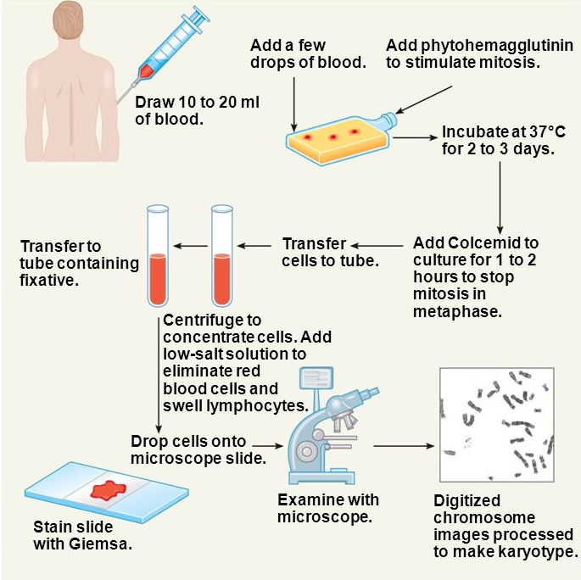
Structural Genomics - Chromosome structure
Studying a virus or prokaryote with one “chromosome”? Easy, count to one
Eukaryote? It gets complicated…
Why do we care?
Infer evolution from chromosome structure
Predict disease inheritance
Determine abnormal chromosomes
Aid scaffolding of genome assemblies
Simplify genome sequencing/analysis (complex genomes)
How do you know how many chromosomes there are?
Perform a karyotype
Arrest the cells at metaphase, stain, look under a microscope
Why metaphase? Chromosomes nicely condensed and visible
Colcemid/colchicine -> depolymerize microtubules
Different stains -> Different banding patterns
G-Banding -> Giemsa stain
Q-Banding -> Quinacrine stain
3
Notes:
https://www.ncbi.nlm.nih.gov/books/NBK22266/
http://www.pathology.washington.edu/research/cytopages/idiograms/human/

Slide 22
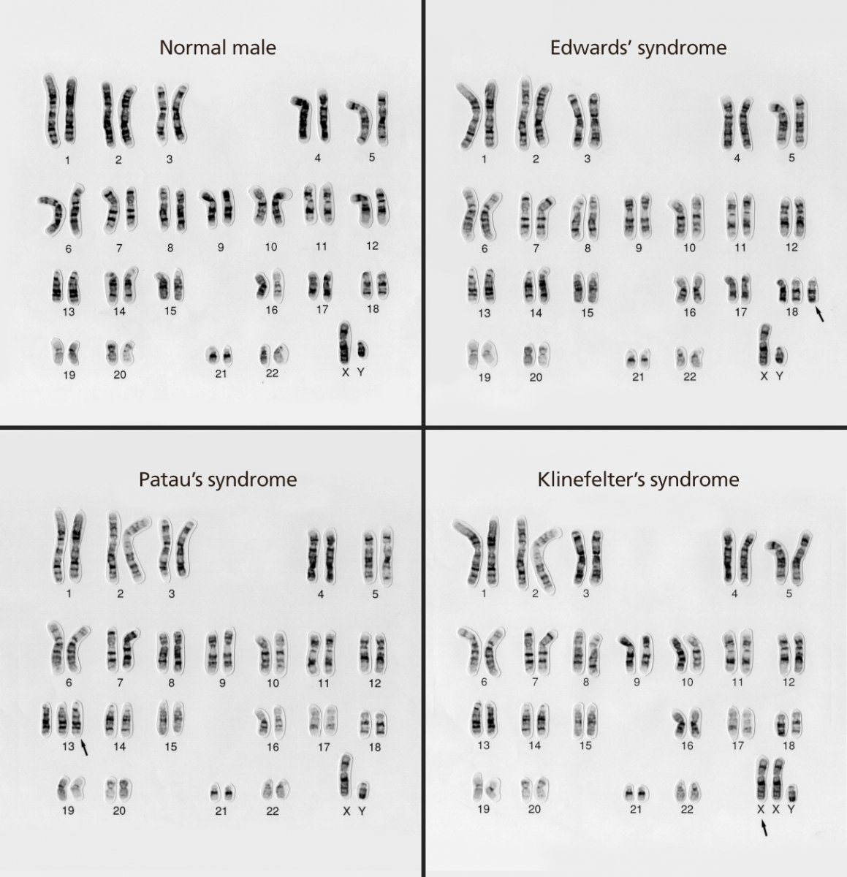
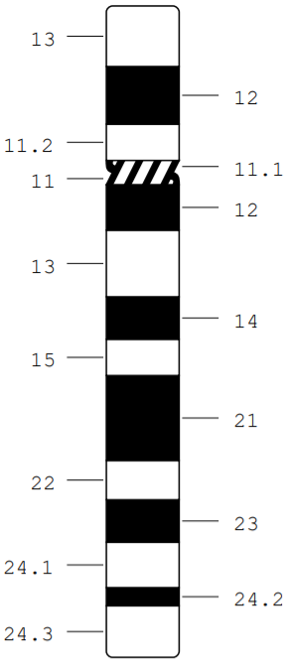
Structural Genomics - Chromosome structure
Karyotyping still very common in clinical setting
Banding pattern -> Method of orienting yourself
International System for Cytogenetic Nomenclature (ISCN)
Gives you rough location on chromosome
For example: 12q15 = Chromosome 12, long arm, region 1, band 5
p = petite, q = q…uite big?
P
Q
4
Notes:
https://www.ncbi.nlm.nih.gov/books/NBK22266/
http://www.pathology.washington.edu/research/cytopages/idiograms/human/

Slide 23
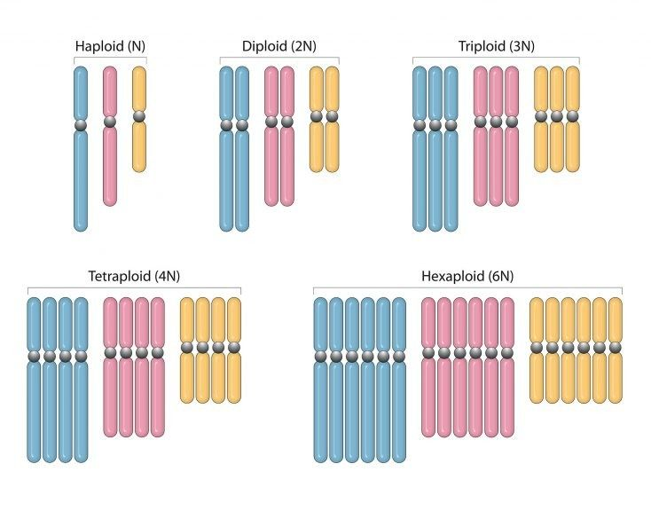
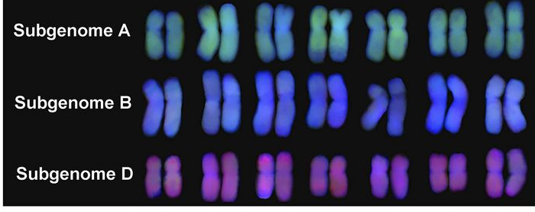
Structural Genomics - Chromosome structure
Ploidy – How many sets of chromosomes in a cell?
Eukaryotes tend to be diploid, mammals don’t tolerate polyploidy well (with some exceptions)
Humans – diploid, 22 autosomes, 1 sex chromosome, 2n = 2x = 46
Plants can tolerate chromosomal rearrangements/duplications
Result? Triticum aestivum, bread wheat, 2n = 6x = 42 -> Six copies of seven chromosomes, 3 sub-genomes
5

Slide 24
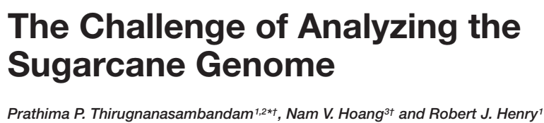



Structural Genomics - Chromosome structure
Extreme example? Sugercane hybrids -> 2n = 5-16x = 40-128 total chromosome number!
What do I have to understand from this paper???
Why is the Sugarcane genome hard to sequence/work with?
What are some of the methods in overcoming these challenges
6
Notes:
Paper #1: The Challenge of Analyzing the Sugarcane Genome

Slide 25

Structural Genomics - Chromosome structure
- More chromosomes = more gene copies = more difficult sequencing and assembly
7
Notes:
Paper #1: The Challenge of Analyzing the Sugarcane Genome

Slide 26



Structural Genomics - Chromosome structure
Flow cytometry + karyotyping = Flow karyotyping!
Stain chromosome prep (Ethidium bromide, Hoescht 33258/Chromomycin A3)
Detect chromosomal abnormalities
Sort and concentrate specific chromosomes (useful for genome sequencing!!!)
8
Notes:
Chromosomes in the flow to simplify genome analysis

Slide 27


Structural Genomics - Chromosome structure
Crested Wheatgrass -> Potential source for beneficial traits for breeding 2x=2n=14
Difficult genome to sequence (2x human genome, more repeats), would be nice to break up
Monovariate – DAPI, Bivariate -> Dapi x FITC-A
Needed to bring in wheat chromosome addition lines (wheat background + 1 extra wheatgrass chromosome)
What do I have to understand from this paper???
Why is sorting plant chromosomes useful
Were the authors able to sort individual chromosomes with mono/divariate sorting?
How were the authors finally able to sort out individual chromosomes of crested wheatgrass?
9
Notes:
Paper #2: Dissecting the Complex Genome of Crested Wheatgrass by Chromosome Flow Sorting

Slide 28


Structural Genomics - Chromosome structure
Crested Wheatgrass -> Potential source for beneficial traits for breeding 2x=2n=14
Difficult genome to sequence (2x human genome, more repeats), would be nice to break up
Monovariate – DAPI, Bivariate -> Dapi x FITC-A
Needed to bring in wheat chromosome addition lines (wheat background + 1 extra wheatgrass chromosome)
10
Notes:
Dissecting the Complex Genome of Crested Wheatgrass by Chromosome Flow Sorting

Slide 29


Structural Genomics – Location of genes
Which gene on which chromosome? Where?
Oldie but goodie -> Linkage mapping
Step 1: Crossing organisms
Cross between organism with/without phenotype/marker
Step 2: Testing offspring for a phenotype or marker
Early days -> Visible phenotype
Restriction fragment length polymorphisms (RFLPs) – Does a person have a restriction site or not?
Microsatellites – Repetitive DNA sequences with high mutation rates – How many repeats does an organism have?
Small Nucleotide Polymorphisms (SNPs) – Positions in nucleotide sequence where individuals have specific mutations
Step 3: Calculating recombination frequency
Genes close together? Less frequently observed together
Genes far apart? More frequently observed together
11
Notes:
https://www.khanacademy.org/science/ap-biology/heredity/non-mendelian-genetics/a/linkage-mapping
https://www.ncbi.nlm.nih.gov/books/NBK22266/
Modern Linkage Mapping with polymorphic DNA markers — a tool for finding genes
Markers and mapping revisited: finding your gene

Slide 30



Structural Genomics – Location of genes
- Fluorescence in situ hybridization (FISH)
Fluorescently labeled DNA probe, need prior knowledge of gene sequence
Probes can be small, 1-2kb, to find a location of gene on chromosomes
Can be big, 100s of kb to detect chromosomal re-arrangements (ABL + BCR -> chronic myeloid leukemia)
12
Notes:
http://www.cancergeneticsitalia.com/wp-content/uploads/2012/05/ABL1-BCR2.pdf

